Slide 1
TYPE MODIFIER
ANISH A R

Slide 2
Type Modifiers
Modifiers are keywords added to basic data types (mostly int and char) to alter how much memory they use or change the range of numbers they can hold.
There are two types of type modifiers:
Sign Modifiers (signed vs unsigned).
Size Modifiers (short vs long).

Slide 3
Sign Modifier
Sign modifiers do not change the amount of memory a variable uses. Instead, they change how the computer interprets the very first bit of that memory space (the Sign Bit).
There are two types of sign modifiers:
Signed .
Unsigned.

Slide 4
Signed
The Behavior:
Tells the compiler that the variable can hold both positive and negative numbers.
How it Works:
The computer splits the number range right down the middle. Half goes to negative numbers, and half goes to positive numbers.
Note:
Writing signed int x; is exactly the same as writing int x;. C assumes everything is signed by default.

Slide 5
Unsigned
The Behavior:
Strips away the negative spectrum completely, forcing the variable to hold only positive numbers and zero.
The Superpower:
Because you throw away the negative scale, you free up the sign bit. This doubles the maximum positive number the variable can reach.
Format Specifier:
You must use %u instead of %d when printing unsigned values.

Slide 6
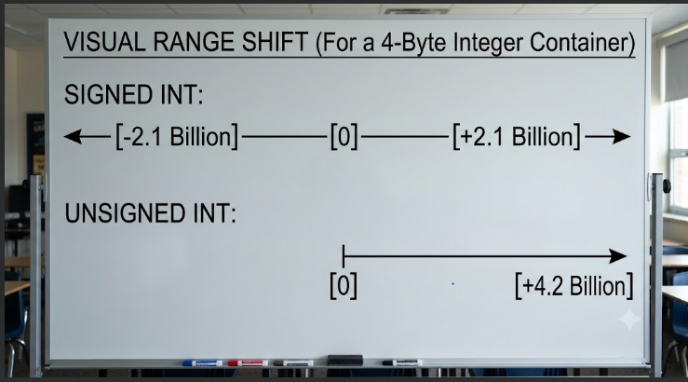

Slide 7
Size Modifiers
Size modifiers change the physical size—the exact number of bytes of RAM—allocated for your data.
There are three types of size modifiers:
Short.
Long.
Long Long.

Slide 8
Short
The Behavior:
Shrinks the variable to use less memory.
The Footprint:
Reduces an integer from 4 bytes down to 2 bytes (16 bits) of RAM.
Format Specifier:
Use %hd to print.
Range:
Can only hold numbers from -32,768 to 32,767.
Best For:
Low-spec embedded hardware or huge datasets where saving every single byte of RAM matters.

Slide 9
Long
The Behavior:
Guarantees the variable will have at least as much space as a standard integer, often expanding it on 64-bit systems.
The Footprint:
Allocates 4 or 8 bytes of RAM.
Format Specifier:
Use %ld to print.

Slide 10
Long Long
The Behavior:
Forces the absolute maximum integer container possible.
The Footprint:
Allocates a full 8 bytes (64 bits) of memory.
Format Specifier:
Use %lld to print.
Range:
Holds giant numbers up to 9 quintillion (approx 9 X 10^{18}).

Slide 11
Modification With int
Exact Variable Declaration | Byte Size | Format Specifier | Absolute Numerical Range
short int | 2 | %hd | -32,768 to 32,767
unsigned short int | 2 | %hu | 0 to 65,535
int (or signed int) | 4 | %d | -2.1 Billion to +2.1 Billion
unsigned int | 4 | %u | 0 to 4.2 Billion
long long int | 8 | %lld | -9 Quintillion to +9 Quintillion
unsigned long long int | 8 | %llu | 0 to 18 Quintillion

Slide 12
Modifiers with Char
Characters are fundamentally small 1-byte integers under the hood, so they respond perfectly to sign modifiers but reject size modifiers.
signed char:
Holds small numbers from -128 to 127. This is the standard behavior on most systems when you type char.
unsigned char:
Strips negative capabilities. The range shifts from 0 to 255.
short char or long char:
Compilation Error! A character is locked at exactly 1 byte. You cannot shrink it or expand it.

Slide 13
Modifiers with Floating-Point Types
Sign Modifiers (signed / unsigned)
unsigned float or unsigned double:
Compilation Error! Floating-point numbers are structurally required to support both positive and negative values. The unsigned keyword cannot be applied to them.
Size Modifiers (short / long)
short float or long float:
Compilation Error! These do not exist in the C standard.
short double:
Compilation Error! If you want a smaller fraction container, you simply use a regular float.

Slide 14
Modifiers with Floating-Point Types
long double:
Perfectly Valid! This is a highly critical type that expands a standard 8-byte double into a 12 to 16-byte ultra-precision storage tank. It handles hyper-detailed scientific computations without accumulating rounding errors. Use the %Lf format specifier to display it.

Slide 15
THANK YOU

